Slide 1
1
OBJECT-ORIENTED & OBJECT- RELATIONAL DATABASES
Dr. A.C.S RAO
Indian Institute of Technology (ISM) DHANBAD

Slide 2


CLASS AND OBJECT
A ‘class’ is in replacement of ‘relation’
• All objects belonging to a same class share the same properties and behavior
• An ‘object’ can be thought of as ‘tuple’ (but richer content) or a blueprint of class
• Classes encapsulate data + methods + relationships
• Unlike relations that contain data only

Slide 3
OBJECT IDENTITY
OID is a unique identity of each object regardless of its content
• Even if all attributes are the same, still objects have different OIDs
• Easier for references
• An object is made of two things:
• State: attributes (name, address, birth Date of a person)
• Behavior: operations (age of a person is computed from birth Date and current date)
**three( structure, behavior, characteristics of types)
Object identity: An object retains its identity even if some or all of the values of variables or definitions of methods change over time.

Slide 4
OBJECT IDENTITY (CONT’D)
This concept of object identity is necessary in applications but doe not apply to tuples of a relational database.
Object identity is a stronger notion of identity than typically found in programming
languages or in data models not based on object orientation.
Several forms of identity:
value: A data value is used for identity (e.g., the primary key of a tuple in a relational
database).
name: A user-supplied name is used for identity (e.g., file name in a file system).
built-in: A notion of identity is built-into the data model or programming languages, and no
user-supplied identifier is required (e.g., in OO systems).

Slide 5
OBJECT IDENTITY (CONT’D)
Object identity is typically implemented via a unique, system-generated OID. The value of the OID is not visible to the external user, but is used internally by the system to identify each object uniquely and to create and manage inter-object references.
There are many situations where having the system generate identifiers automatically is a benefit, since it frees humans from performing that task. However, this ability should be used with care.
System-generated identifiers are usually specific to the system, and have to be translated if data are moved to a different database system.
System-generated identifiers may be redundant if the entities being modeled already have unique identifiers external to the system,
e.g., SIN#.

Slide 6
STONEBRAKER’S APPLICATION MATRIX
No Query Query
Complex Data
Simple Data
OODBMS | ORDBMS
File System | RDBMS

Slide 7
RELATIONAL MODEL
Relations are the key concept, everything else is around relations
Primitive data types, e.g., strings, integer, date, etc.
Great normalization, query optimization, and theory
What is missing??
Handling of complex objects
Handling of complex data types
Code is not coupled with data
No inheritance, encapsulation, etc.

Slide 8
TWO APPROACHES
Object-Oriented Model (OODBMS)
Pure OO concepts
Object-Relational Model (ORDBMS)
Extended relational model with OO concepts

Slide 9


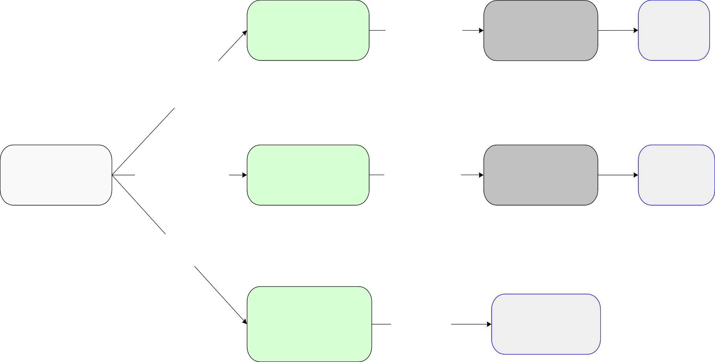
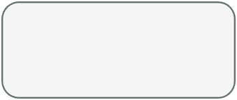
LOGICAL & PHYSICAL LAYERS
ER diagram
Relational database design
Normalization & Physical design
SQL
table definitions
RDBMS
Mapping onto Relations
(no operations)
UML class diagram
Mapping onto Relations and Object types
Object-Relational database design
Normalization & Physical design
Extended-SQL table definitions
ORDBMS
Mapping directly onto ODL classes
Object-Oriented database schema in ODL
Optimization
OODBMS

Slide 10
EXAMPLE OF UML CLASSES
Person
Class Name
name: {firstName: string, middleName: string, lastName: string}
address: string birthDate: date
Attributes
age(): Integer
changeAddress(newAdd: string)
Operations
p:Person
A Person object
name: {Norman, William, Preston}
address: Stockport
birthDate: 11-JUN-70

Slide 11
FIRST APPROACH: OBJECT-ORIENTED MODEL
Relations are not the central concept, classes and objects are the main concept
Object-Oriented DBMS(OODBMS) are DBMS based on an Object- Oriented Data Model inspired by OO programming languages
Main Features:
Powerful type system
Classes
Object Identity
Inheritance
OODBMS are capable of storing complex objects, I.e., objects that are composed of other objects, and/or multi-valued attributes.

Slide 12

FEATURE 1: POWERFUL TYPE SYSTEM
Primitive types
Integer, string, date, Boolean, float, etc.
Structure type
Attribute can be a record with a schema
Struct {integer x, string y}
Collection type
Attribute can be a Set, Bag, List, Array of other types
Reference type
Attribute can be a Pointer to another object

Slide 13
FEATURE 2: CLASSES
A ‘class’ is in replacement of ‘relation’
Same concept as in OO programming languages
All objects belonging to a same class share the same properties and behavior
An ‘object’ can be thought of as ‘tuple’ (but richer content)
Classes encapsulate data + methods + relationships
Unlike relations that contain data only
In OODBMSs objects are persistency (unlike OO programming languages)

Slide 14
FEATURE 3: OBJECT IDENTITY
OID is a unique identity of each object regardless of its content
Even if all attributes are the same, still objects have different OIDs
Easier for references
An object is made of two things:
State: attributes (name, address, birthDate of a person)
Behaviour: operations (age of a person is computed from birthDate and current date)

Slide 15
FEATURE 4: INHERITANCE
A class can be defined in terms of another one.
Person is super-class and Student is sub-class.
Student class inherits attributes and operations of Person.
Person
name: {firstName: string, middleName: string, lastName: string} address: string birthDate: date
age(): Integer changeAddress(newAdd: string)
Student
regNum: string {PK} major: string
register(C: Course): boolean

Slide 16
STANDARDS FOR OBJECT-ORIENTED MODEL
ODMG: Object Data Management Group (1991)
provide a standard where previously there was none
support portability between products
standardize model, querying and programming issues
Language of specifying the structure of object database
ODL: Object Definition Language
OQL: Object Query Language
ODL is somehow similar to DDL (Data Definition Language) in SQL

Slide 17
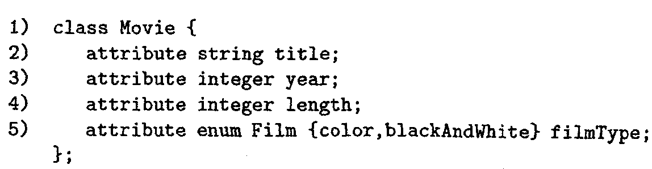
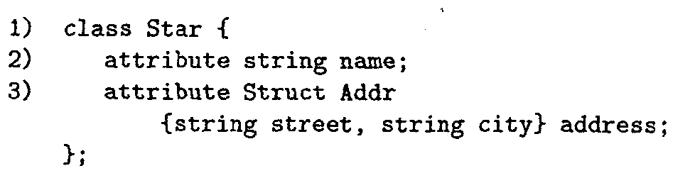
ODL: CLASSES & ATTRIBUTES
Keyword attribute
Two classes with their attributes
Attribute as a structure

Slide 18
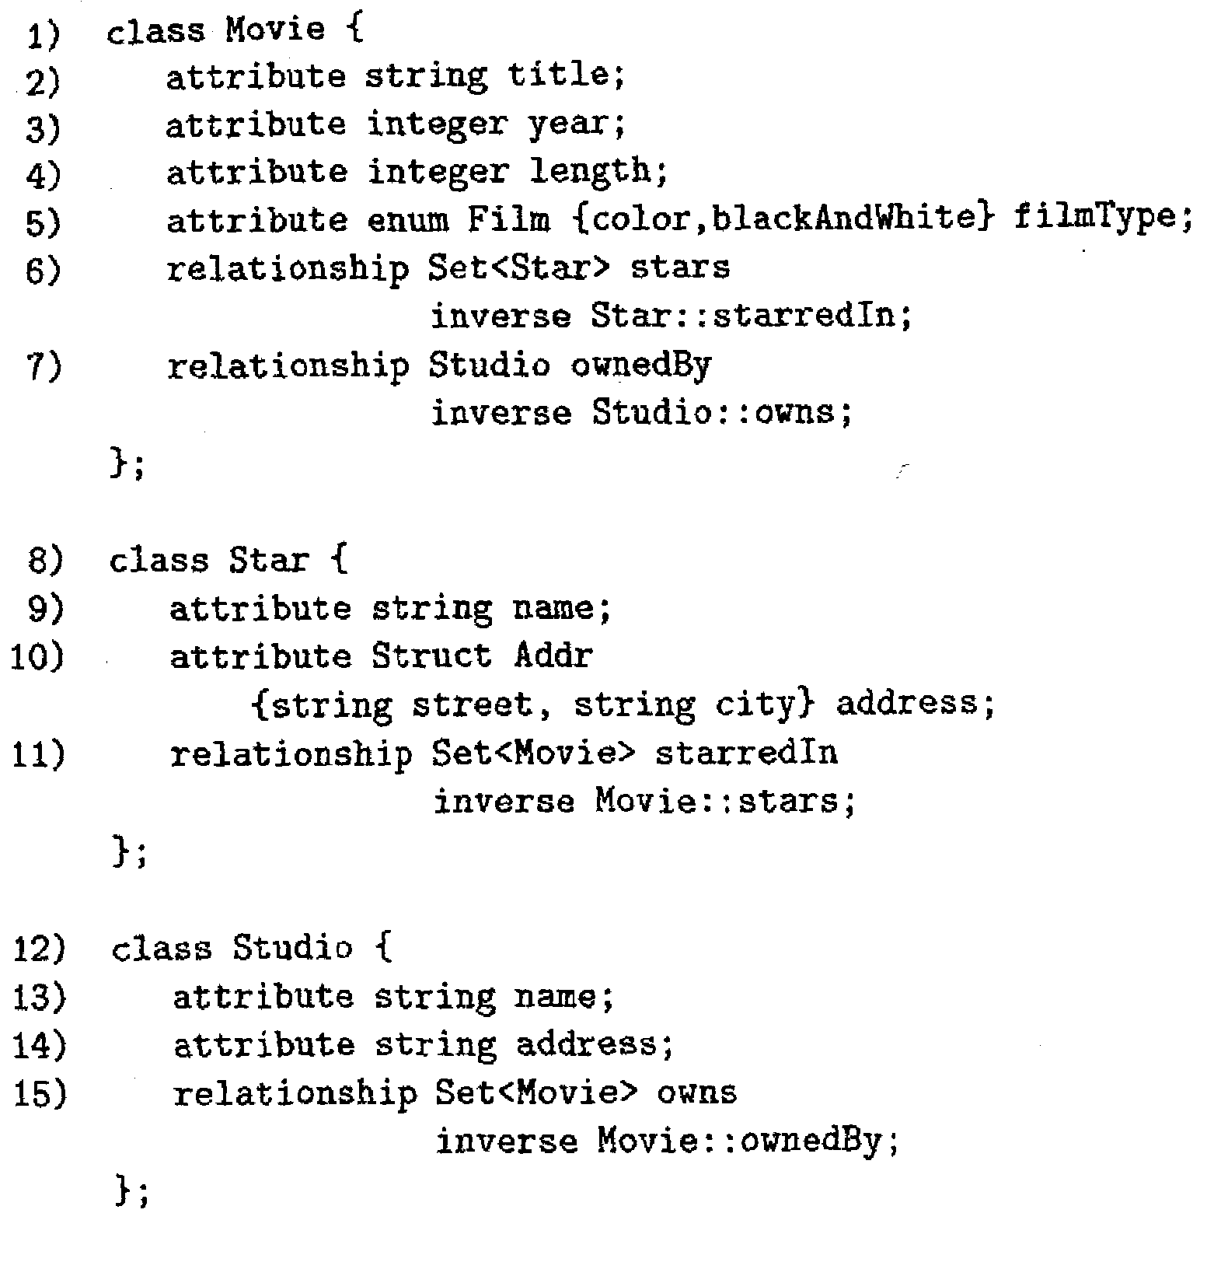




ODL: RELATIONSHIPS
Keyword relationship
Keyword set
Set: set of unsorted unique objects
Bag: set of unsorted objects with possible duplication
List: set of sorted list
Array: set of sorted list referenced by index

Slide 19
ODL: RELATIONSHIPS & INVERSE RELATIONSHIPS
Keyword inverse
Inverse of each other

Slide 20



ODL: MULTIPLICITY OF RELATIONSHIPS
Based on the use of collection types (set, bag, etc.)
Many-to-Many relationship
One-to-Many relationship
What about multiway relationships???
--Not supported
--Need to convert a multiway to multiple binary relationships

Slide 21
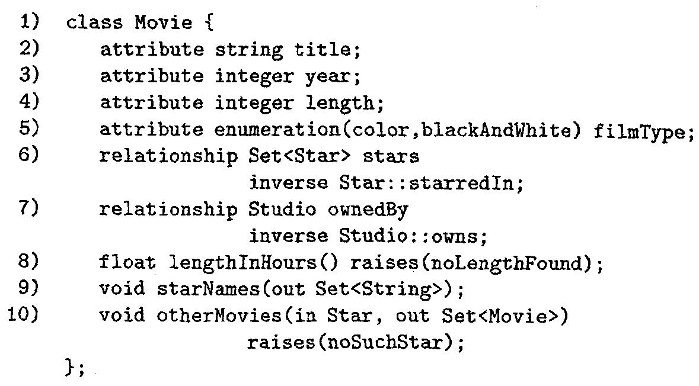
ODL: METHODS
Three methods declarations
Parameters are either IN, OUT, or INOUT
Definition (implementation) is not part of the class

Slide 22
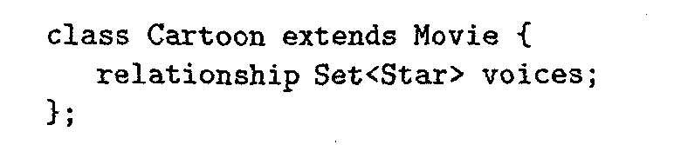
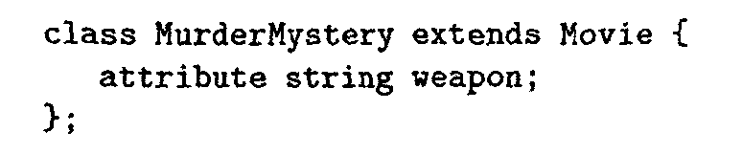
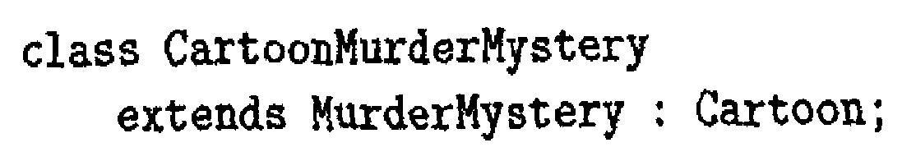
ODL: INHERITANCE
Same Idea as in OO programming (C++ or Java)
Subclass inherits all attributes, relationships, and methods
Plus adding additional fields
Keyword extends
Cartoon movie is a movie with voices of characters
Murder movie is a movie with the weapons used
Inherits from two other classes

Slide 23
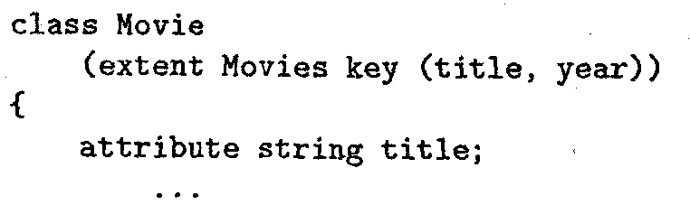
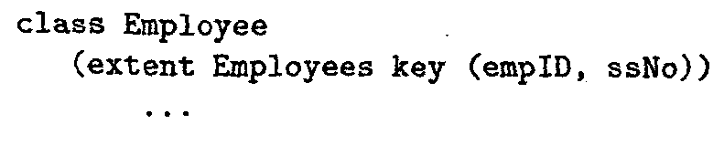
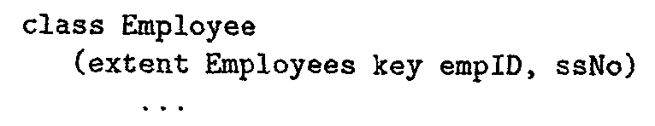
ODL: INSTANCES & KEYS
Instance of a class are all objects currently exist of that class
In ODL that is called extent (and is given a name)
Keys are not as important for referencing objects
Because each object already has a unique OID
Defining keys in ODL is optional
ODL allows defining multiple keys (Comma separated)
Keywords extent & key
The key is the pair of (title, year)
The key is the pair of (empID, SSN)
Two keys empID and SSN

Slide 24
OQL: OBJECT-ORIENTED QUERY LANGUAGE
OQL is a query language designed to operate on databases described in ODL.
Tries to bring some concepts from the relational model to the ODBMs
E.g., the SELECT statement, joins, aggregation, etc.
Reference of class properties (attributes, relationships, and methods) using:
Dot notation (p.a), or
Arrow notation (p->a)
In OQL both notations are equivalent

Slide 25
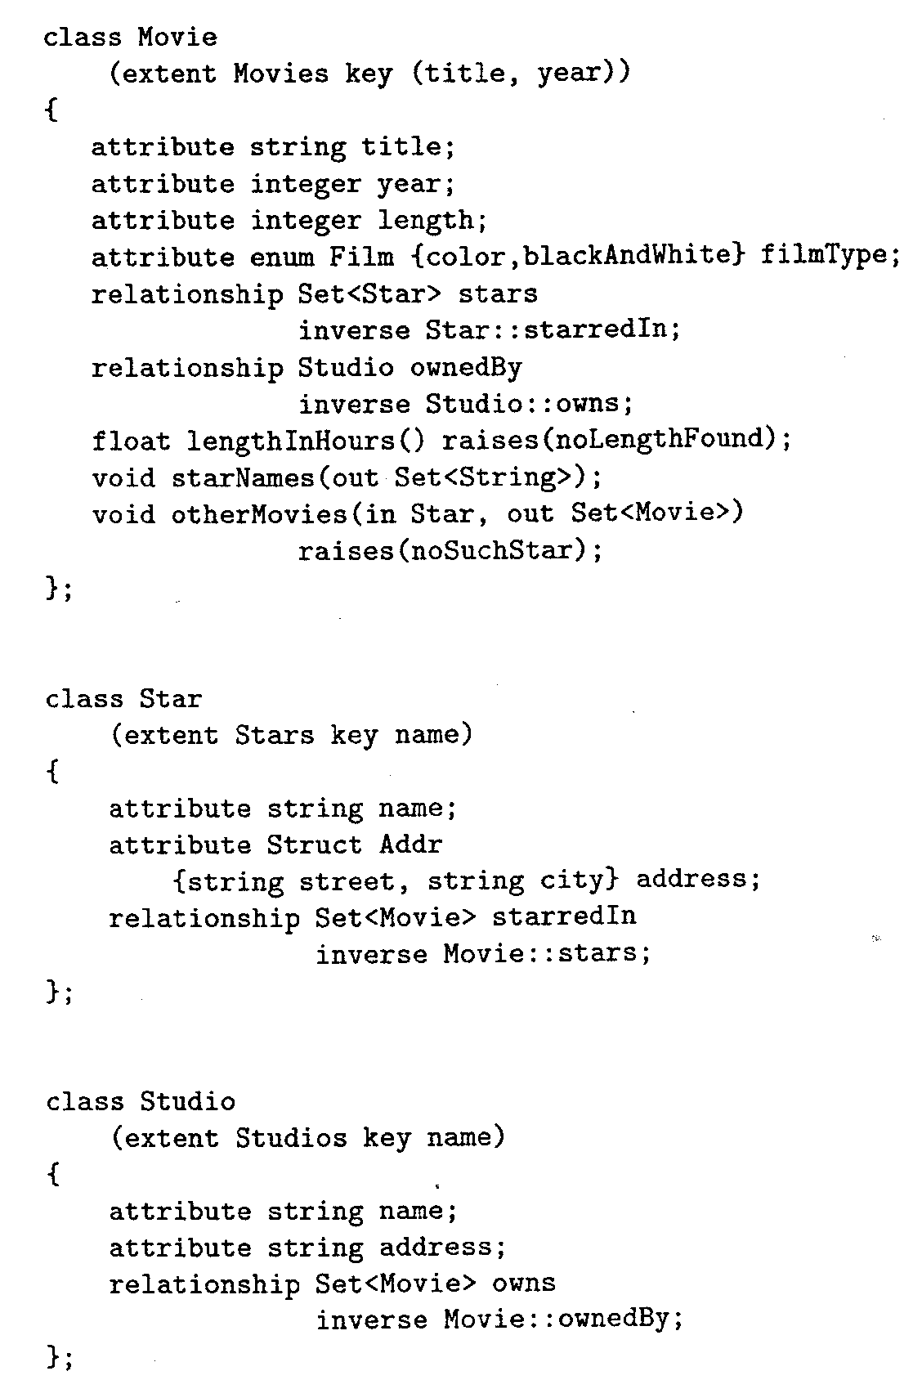
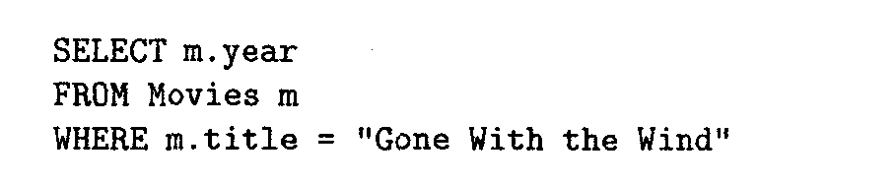
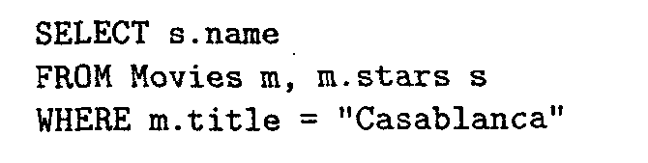


OQL: EXAMPLE QUERIES I
Reference the extent (instance of class)
Select the year of movie ‘Gone with the wind’
For each movie m, s is the set of stars in that movie (follow a relationship)
Select star names from movie ‘Casablanca’
Another notation

Slide 26

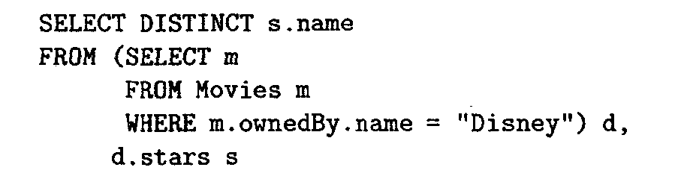
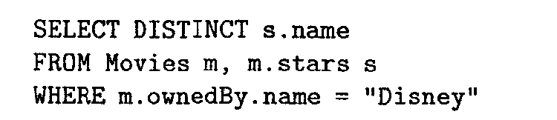
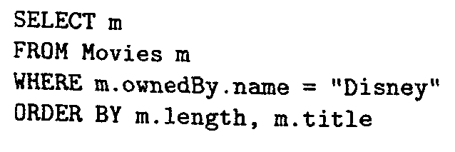
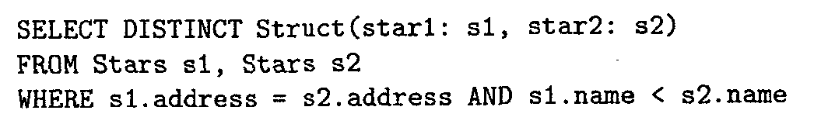
OQL: EXAMPLE QUERIES II
Select distinct star names in movies owned by ‘Disney’
subquery
order movies owned by ‘Disney’ based on length and title
Report set of structures
Join two classes
Report pairs of stats who have the same address

Slide 27
OQL OUTPUT
Unlike SQL which produces relations, OQL produces collection (set, bag, list) of objects
The object can be of any type
Set of strings
Set of objects of type Movie
Set of structures

Slide 28
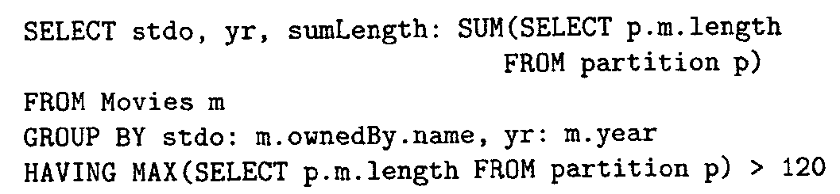

OQL: AGGREGATION
Aggregate over the partition
Intermediate result
Grouping fields
Struct{
stdo: …, yr: …,
partition: bag(struct {m: …})
};
Bag of structures with members follow what’s in the FROM clause
35

Slide 29
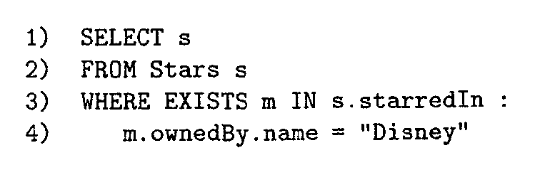
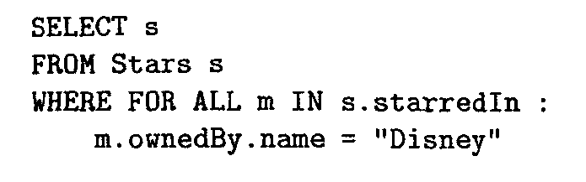
OQL: COLLECTION OPERATORS
Like in SQL, we have ANY, ALL, EXISTS
OQL has similar operators
Select stars who participated in a movie made by ‘Disney’
Select stars who participated only in movies made by ‘Disney’

Slide 30
SECOND APPROACH: OBJECT- RELATIONAL MODEL
Object-oriented model tries to bring the main concepts from relational model to the OO domain
The heart is OO concepts with some extensions
Object-relational model tries to bring the main concepts from the OO domain to the relational model
The heart is the relational model with some extensions
Extensions through user-defined types

Slide 31

CONCEPTUAL VIEW OF OBJECT- RELATIONAL MODEL
Relation is still the fundamental structure
Relational model extended with the following features
Type system with primitive and structure types (UDT)
Including set, bag, array, list collection types
Including structures like records
Methods
Special operations can be defined over the user-defined types (UDT)
Specialized operators for complex types, e.g., images, multimedia, etc.
Identifiers for tuples
Unique identifiers even for identical tuples
References
Several ways for references and de-references

Slide 32

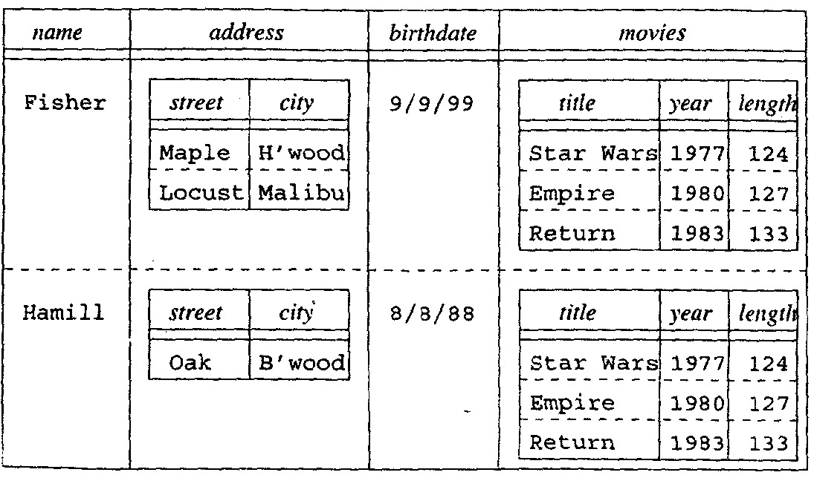
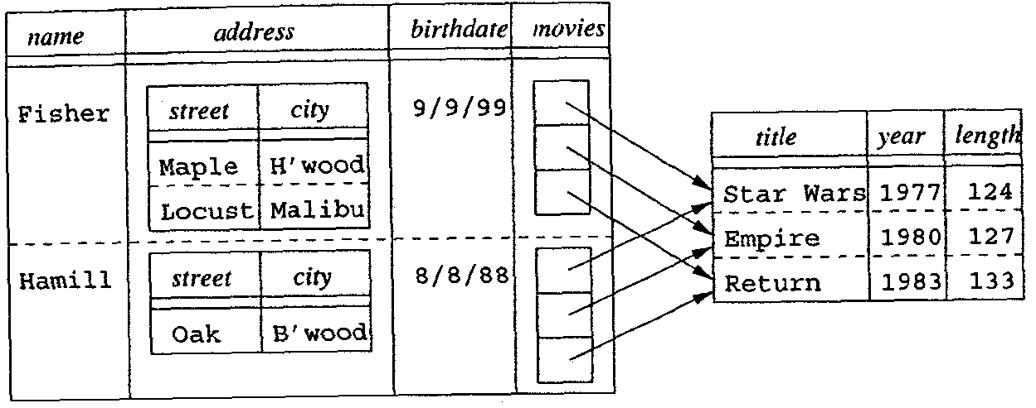
CONCEPTUAL VIEW OF OBJECT- RELATIONAL MODEL
Allow of nested relations
Repeating movies inside the stars records is redundancy
Star(name, address(street, city), birthdate, movies(title, year, length))
To avoid redundancy, use pointers (references)
Movie
Star
41

Slide 33

SQL-99: QUERY LANGUAGE FOR OBJECT- RELATIONAL MODEL
User-defied types (UDT) replace the concept of classes
Create relations on top of the UDTs
Multiple relations can be created on top of the same UDT
Create Type <name> AS (attributes and method declarations)

Slide 34
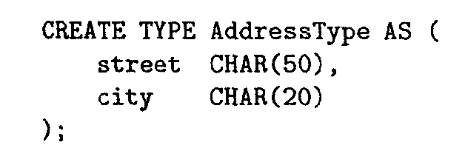
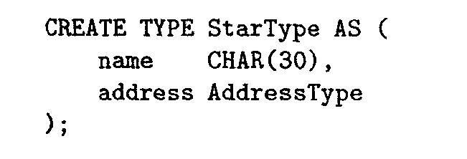
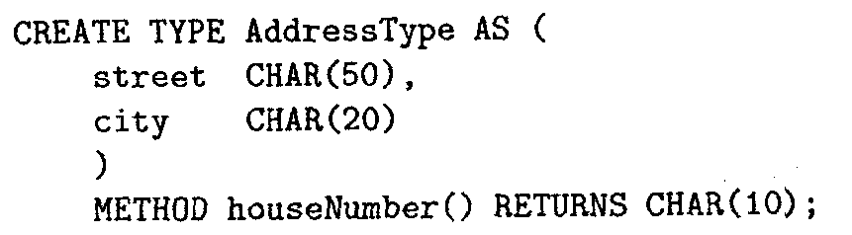

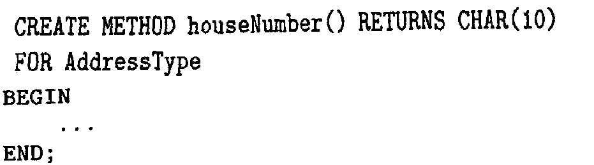
CREATING UDT
Creating a type for the address of stars
A hierarchy of types (inheritance)
Adding a method declaration for a type (not definition) (Encapsulation)

Slide 35




CREATING RELATIONS
Once types are created, we can create relations
In general, we can create tables without types
But types provide encapsulation, inheritance, etc.
Create Table MovieStar OF StarType;
How to define keys and relationships???

Slide 36
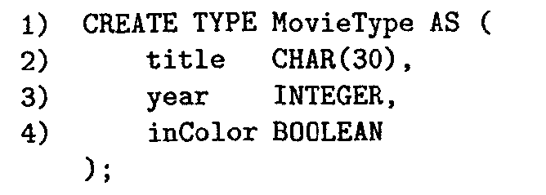
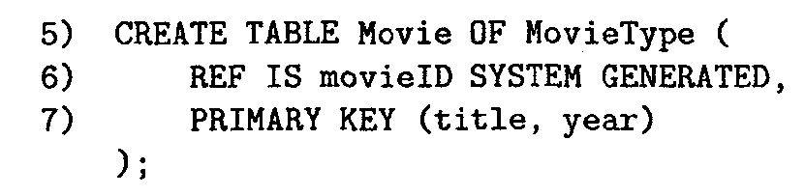
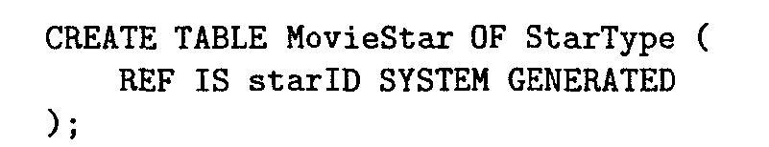
CREATING RELATIONS
A single primary key can be defined using Primary Key
keyword
To reference another relation R, R has to be referenceable
using REF keyword
Tuples can be referenced using attribute movieID (system generated)
Define primary key
Create type for movies
Create Movie table
Referenceable, but no primary key
Create type for stars
Create MovieStar table
47

Slide 37
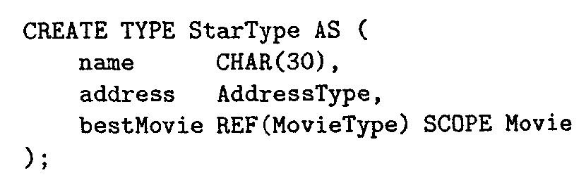
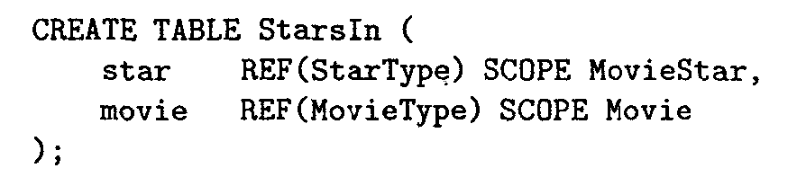
DEFINING RELATIONSHIPS
One-to-many Or one-to-one
Plug it inside the existing types
Many-to-many
Create a new type or new table referencing existing types
For each star, keep the best movie (one-many)
Table for each star participated in which movies (many-many)
SCOPE points to a ‘referenceable’ table

Slide 38


EXAMPLES I
Q1: Find the year of movie ‘King Kong’
Select m.year From Movie m
Where m.title = ‘King Kong’;
Variable m is important to reference the fields
Q2: Find the title of the best movie ’Jim Carry’
Select s.bestMovie->title From MovieStar s
Where s.name = ‘Jim Carry’;
Follow a reference (pointer) using →→ operator

Slide 39


EXAMPLES II: DE-REFERENCING
Q3: Find movies starred by ‘Jim Carry’
Select DEREF(movie) From StarsIn
Where star->name = ‘Jim Carry’;
DEREF: Get the tuple pointed to by the given pointer
Q4: Find movies starred by ‘Jim Carry’ (Another way)
Select s.movie->title, s.movie->year, s.movie->inColor,
From StarsIn s
Where s.star->name = ‘Jim Carry’;
*** Using a variable for StartsIn (s in Q4) is not necessary because the table is not based on type.

Slide 40





ORDERING RELATIONSHIPS
Need to define how to compare objects of a given type T
Equality or non-equality (=, ≠)
Identical content
EQUALS
ONLY BY STATE;
Create Ordering For T
BY RELATIVE WITH F;
ORDERING FULL
User-defined function F(O1, O2) and returns 0, -ve, +ve
Full comparison (=, <, >, ≤, ≥, ≠)

Slide 41
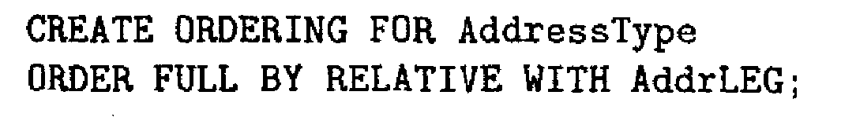
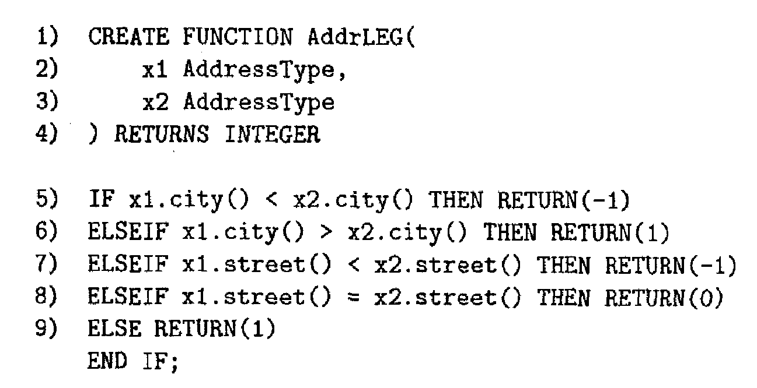
ORDERING FUNCTION

Slide 42



EXAMPLES IV: COMPARISON
Create Ordering For MovieType Equals Only By State;
Q5: Find distinct movies starred by ‘Jim Carry’ or ‘Mel Gibson’
Select Distinct DEREF(movie) From StarsIn
Where star->name = ‘Jim Carry’ Or star->name = ‘Mel Gibson’;

Slide 43

GENERATORS AND MUTATORS
How to insert new new data into tables
Generators
Like the constructors in OO programming
Create new objects
Mutators
Modify the value of an existing object
For each attribute x in UDT T, the system automatically creates:
Generator T() that returns an empty object of T
Mutator x(v) that sets the value of attribute x to value v

Slide 44

CREATING RECORDS OF COMPLEX TYPES
Collection and array types
create type Book as
(title
author-array pub-date publisher keyword-set
varchar(20), varchar(20) array [10], date,
Publisher,
setof(varchar(20)))

Slide 45
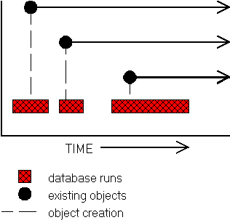

KEY BENEFITS OF ODBMS
Persistence & Versioning
Created objects are maintained across different database runs (persistent)
Different evolving copies of the same object can be created over time (versioning)
PersistentObject Superclass Approach
Superclass encapsulates any class for storage and retrieval
This superclass implements all functionalities of read/write operations

Slide 46

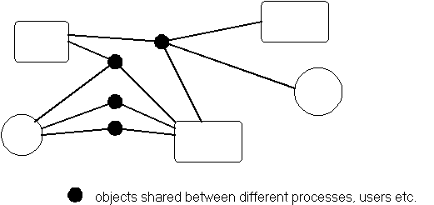
KEY BENEFITS OF ODBMS (CONT’D)
Sharing in highly distributed environment
Easier to share and distribute objects than tables

Slide 47
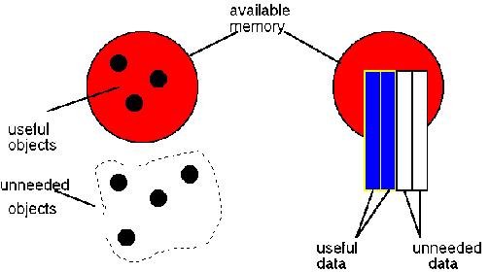
KEY BENEFITS OF ODBMS (CONT’D)
Better memory usage and less paging
Bringing only objects of interest
ODBMS Relational DBMS

Slide 48
MODIFICATIONS TO RDBMS
Parsing
Type-checking for methods pretty complex
Query Rewriting
New rewriting rules including complex types and collections
Optimization
New algebra operators needed for complex types.
Must know how to integrate them into optimization.
WHERE clause exprs can be expensive!
Selection pushdown may be a bad idea.

Slide 49
MODIFICATIONS TO RDBMS (CONT’D)
Execution
New algebra operators for complex types.
OID generation & reference handling.
Dynamic linking and overriding.
Support objects bigger than 1 page.
Caching of expensive methods.
Access Methods
Indexes on methods, not just columns.
Indexes over collection hierarchies.
Need indexes for new WHERE clause exprs (not just <, >, =)
Data Layout
Clustering of nested objects.
Chunking of arrays.

Slide 50
Associations
An association shows a two-way relationship between objects (instances) of two or more classes and requiring special implementation to ensure integrity.
A particular instance of an association is often called a link.
Associations between classes are required if the objects need to communicate.
Associations are often named, and have role-names for each side of the link.

Slide 51
Types of Association
Unary association
both ends of an association circle back to the same class
Binary association
an association that connects exactly two classes
N-ary association
an association that connects more than two classes

Slide 52
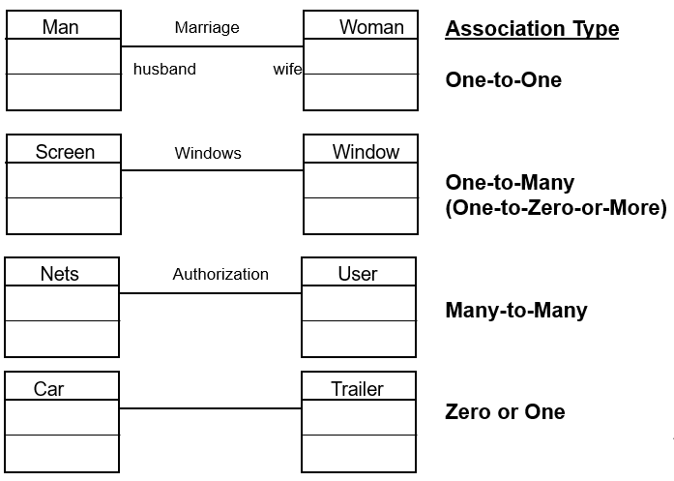
Associations

Slide 53
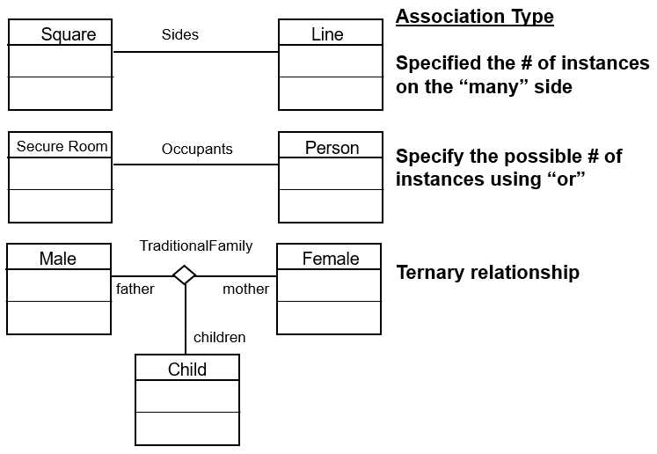
Associations (Conti..)

Slide 54
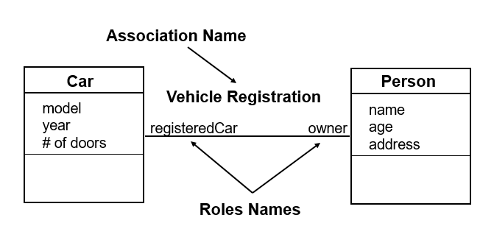
Associations (Conti..)

Slide 55
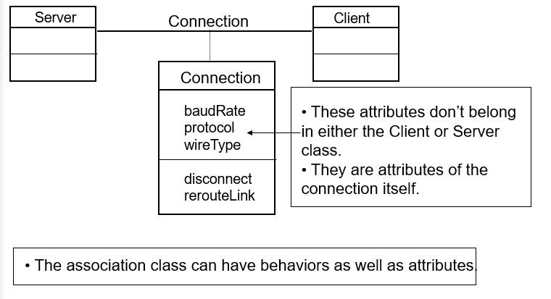
Association Class

Slide 56
Aggregation
Aggregation is a special form of association.
Aggregation is used when the relationship is “part/whole” or “contains/is-part-of”
Aggregation is transitive and operations on “whole” often cascade down to “parts”.

Slide 57
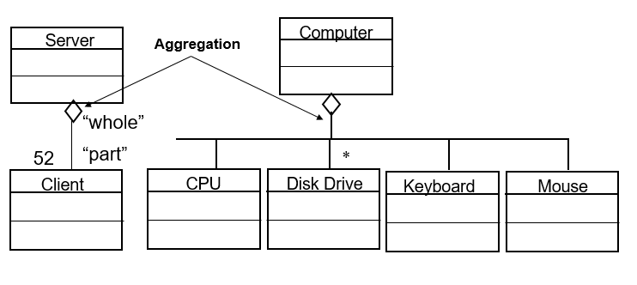
Aggregation (Conti..)

Slide 58
Aggregation (Conti..)
Special diamond symbol used on “whole” side to indicate aggregation.
Aggregation is an anti-symmetric that is, if A is part of B, then B is not part of A.
DO NOT confuse aggregation with generalization
An essential property of aggregates is that the whole acts as a proxy for its parts.
A composition is a strict form of aggregation, in which the parts are existence-dependent on the entirely

Slide 59
Properties of Aggregation
There are certain properties associated with objects in an aggregation that make them different from normal associations.
These may be classed as follows:
Transitivity - If A is part of B and B is part of C then A is part of C
Anti-symmetry - If A is part of B, then B is not part of A. (i.e. not a simple association)
Propagation -The environment of the part is the same as that of the assembly Properties of A
Aggregation can be fixed, variable or recursive.

Slide 60
Generalization & Specialization
Enhanced ER Model = existing ER Model + Generalization, Specialization, Aggregation
Generalization is a bottom-up approach in which two lower level entities combine to form a higher level entity
In generalization, the higher level entity can also combine with other lower level entities to make further higher level entities
It's more like Superclass and Subclass system, but the only difference is the approach, which is bottom-up
Hence, entities are combined to form a more generalized entity. In other words, sub-classes are combined to form a super-class.

Slide 61
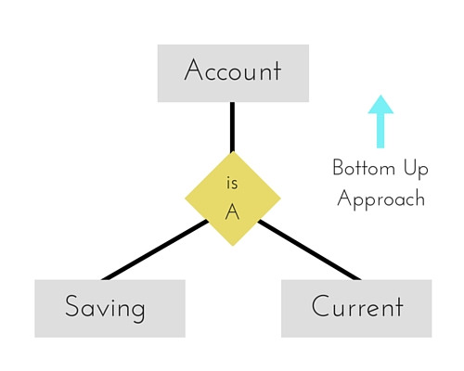
Example Of Generalization
In the figure above, Saving and Current account types entities can be generalized and an entity with name Account can be created, which covers both.

Slide 62
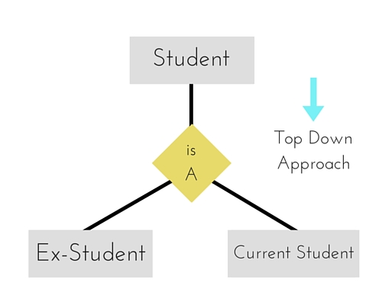
Specialization
Specialization is opposite to Generalization.
It is a top-down approach in which one higher level entity can be broken down into two lower level entity.
In specialization, a higher level entity may not have any
lower-level entity sets.
In the Figure, a top entity, namely Student, can
Be broken down or specialized into to entities –
Ex-Student and Current Student.

Slide 63
Comparison Between Generalization
And Specialization
BASIS FOR COMPARISON | GENERALIZATION | SPECIALIZATION
Basic | It proceeds in a bottom-up manner. | It proceeds in a top-down manner.
Function | Generalization extracts the common features of multiple entities to form a new entity. | Specialization splits an entity to form multiple new entities that inherit some feature of the splitting entity.
Entities | The higher level entity must have lower level entities. | The higher level entity may not have lower level entities.
Size | Generalization reduces the size of a schema. | Specialization increases the size of a schema.
Application | Generalization entities on group of entities. | Specialization is applied on a single entity.
Result | Generalization results in forming a single entity from multiple entities. | Specialization results in forming the multiple entity from a single entity.

Slide 64


COMPARISON
Table 2 A Comparison of Database Management Systems
Criteria | RDBMS | ORDBMS | ODBMS
Defining standard | SQL2 (ANSI X3H2) | SQL3/4 (in process) | ODMG-V2.0
Support for object-oriented programming | Poor; programmers spend 25% of coding time mapping the program object to the database | Limited mostly to new data types | Direct and extensive
Simplicity of use | Table structures easy to understand; many end- user tools available | Same as RDBMS, with some confusing extensions | OK for programmers; some SQL access for end users
Simplicity of development | Provides independence of data from application, good for simple relationships | Provides independence of data from application, good for simple relationships | Objects are a natural way to model; can accommodate a wide variety of types and relationships
Extensibility and content | None | Limited mostly to new data types | Can handle arbitrary complexity; users can write methods and on any structure
Complex data relationships | Difficult to model | Difficult to model | Can handle arbitrary complexity; users can write methods and on any structure
6
70

